Slide 1





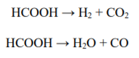
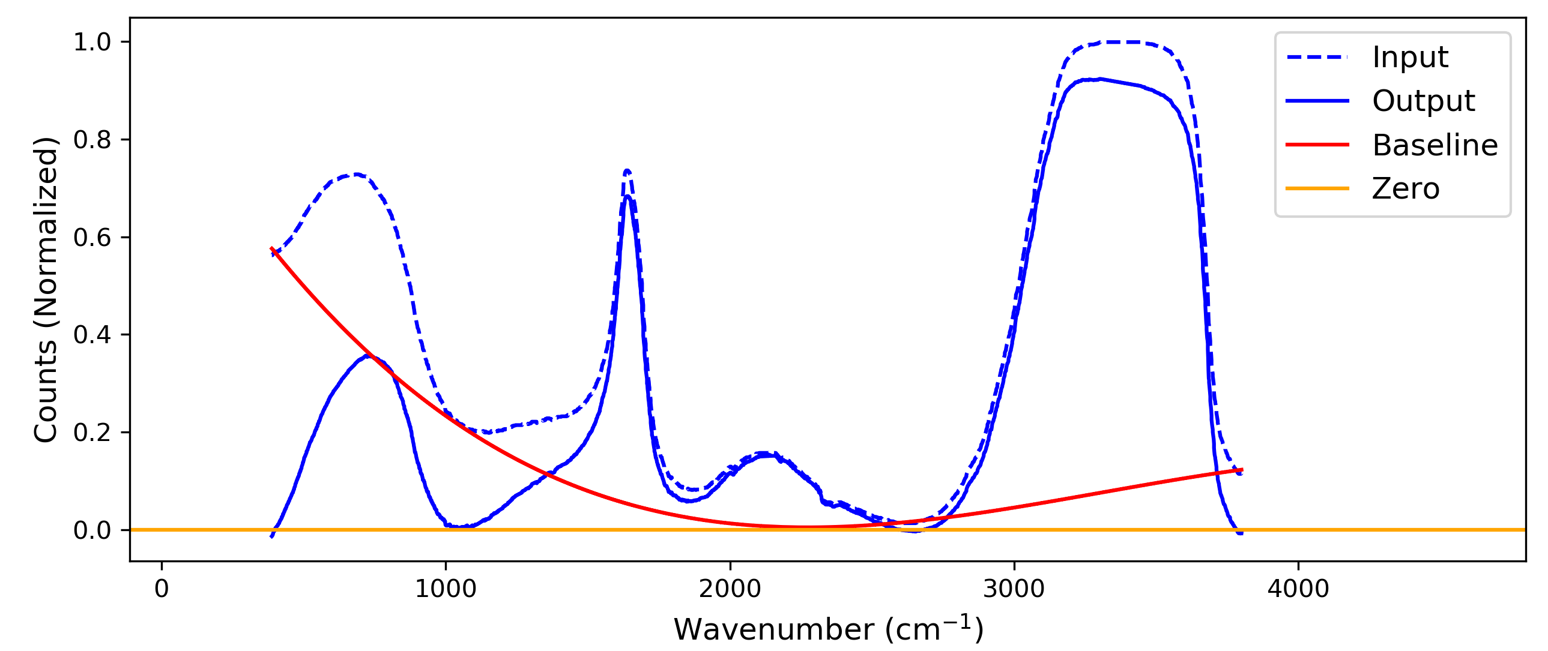
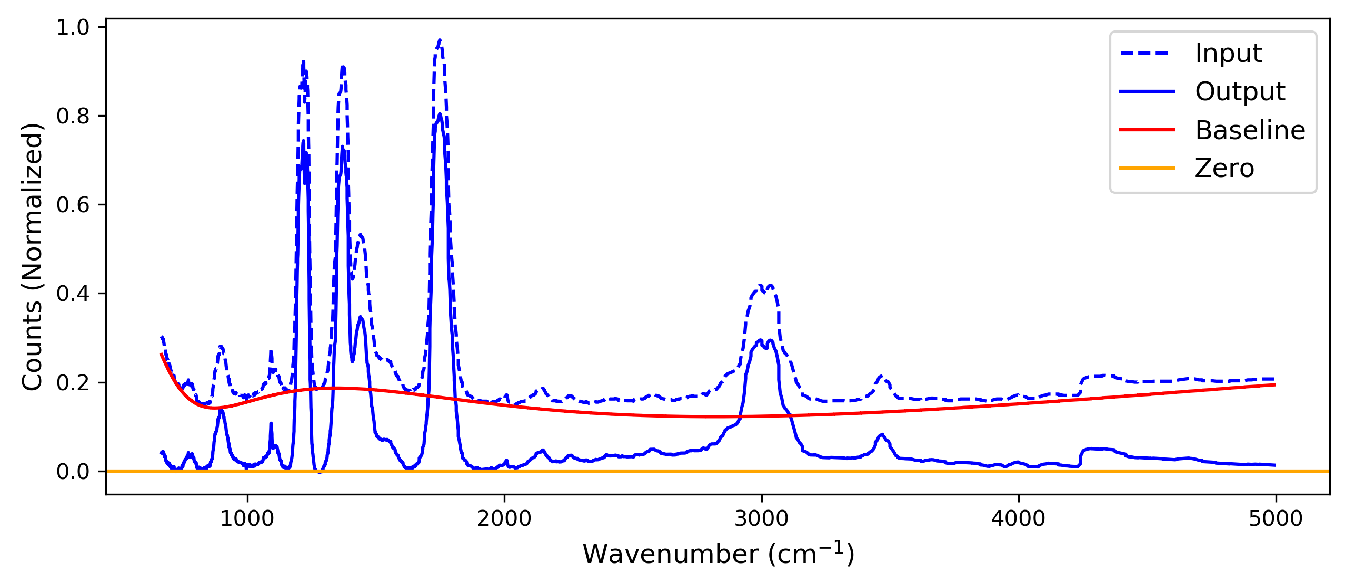
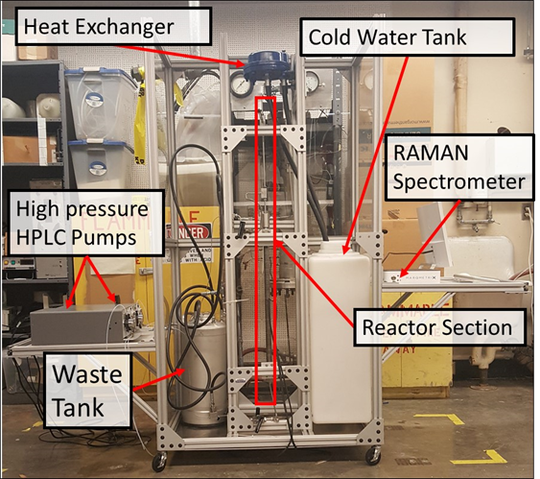
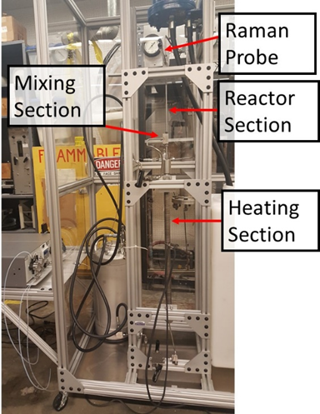
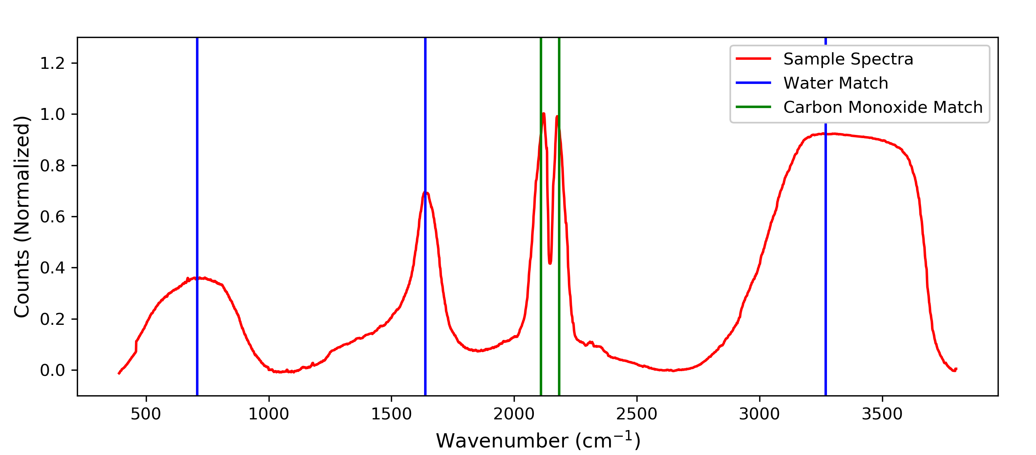
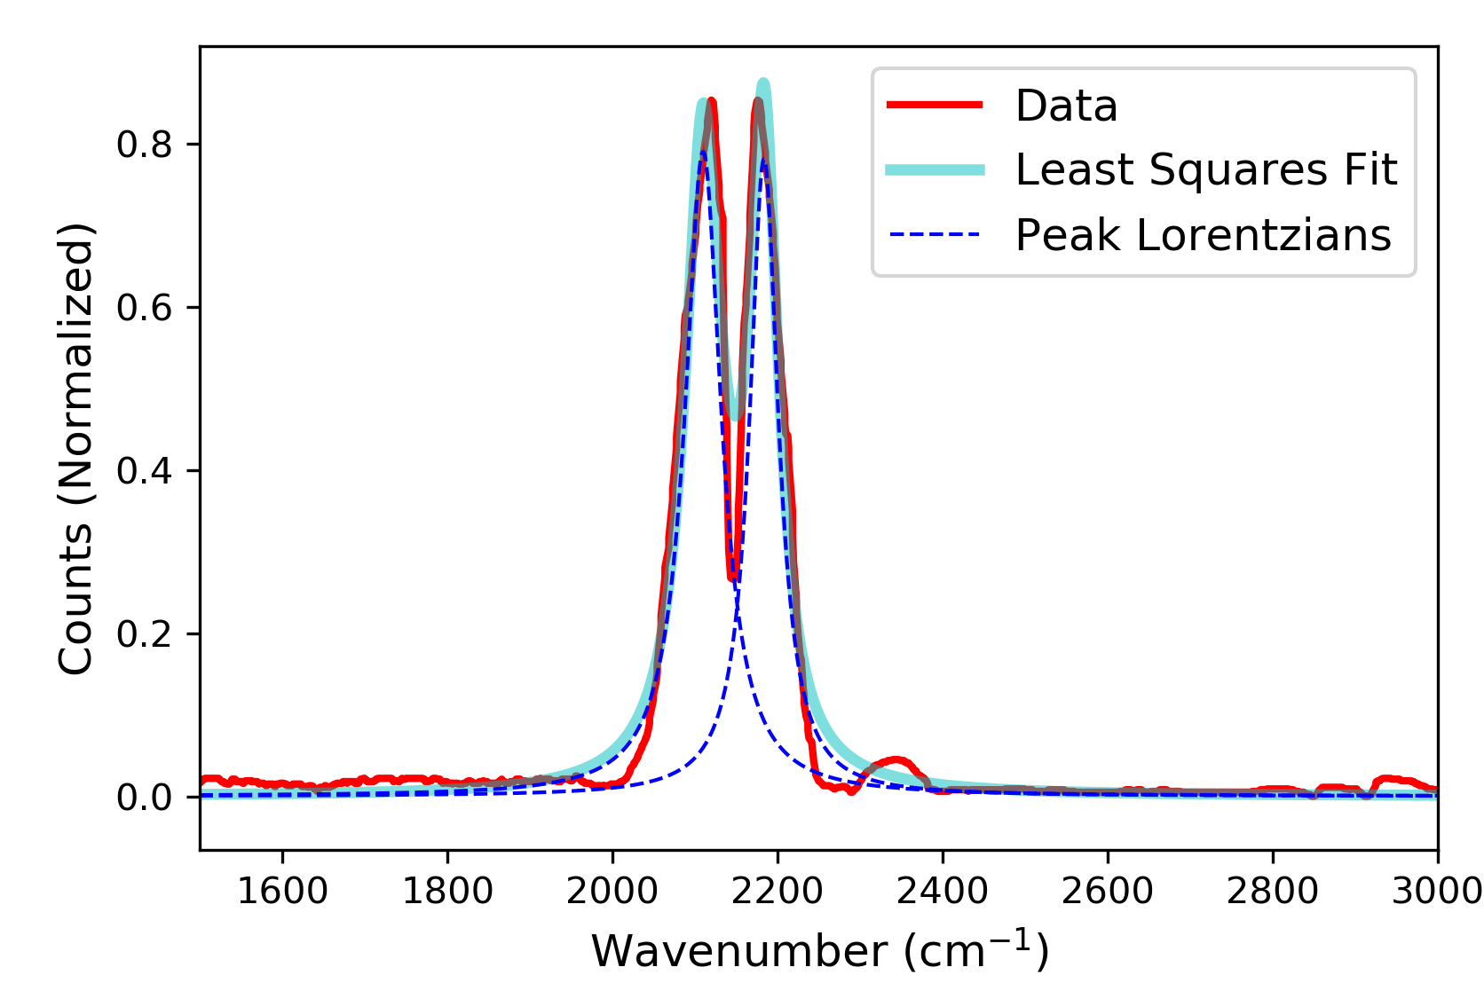
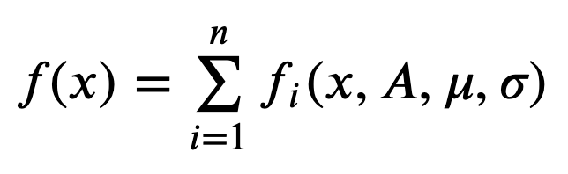
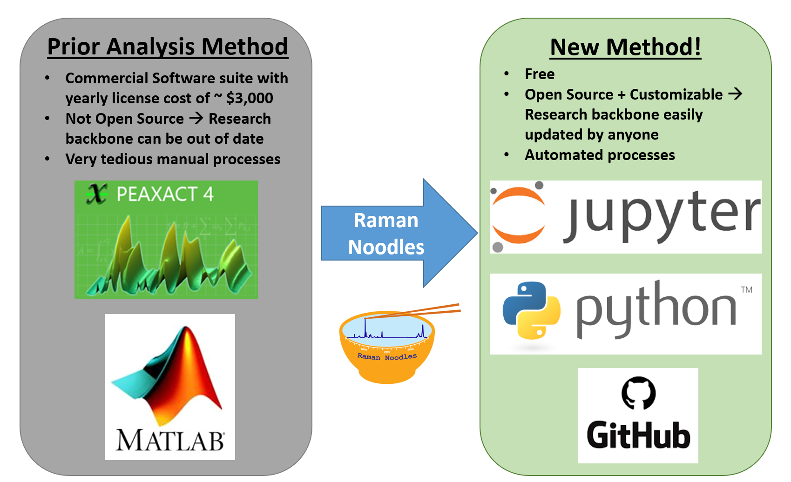
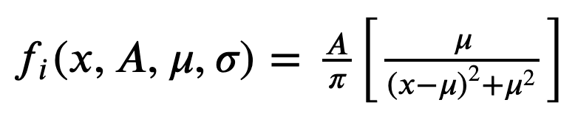
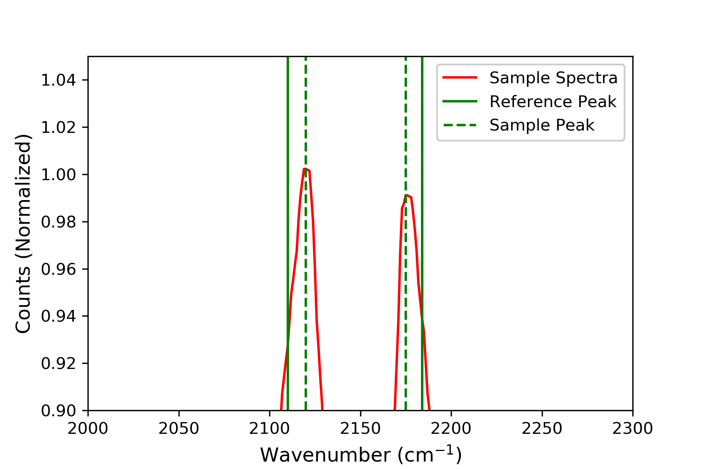
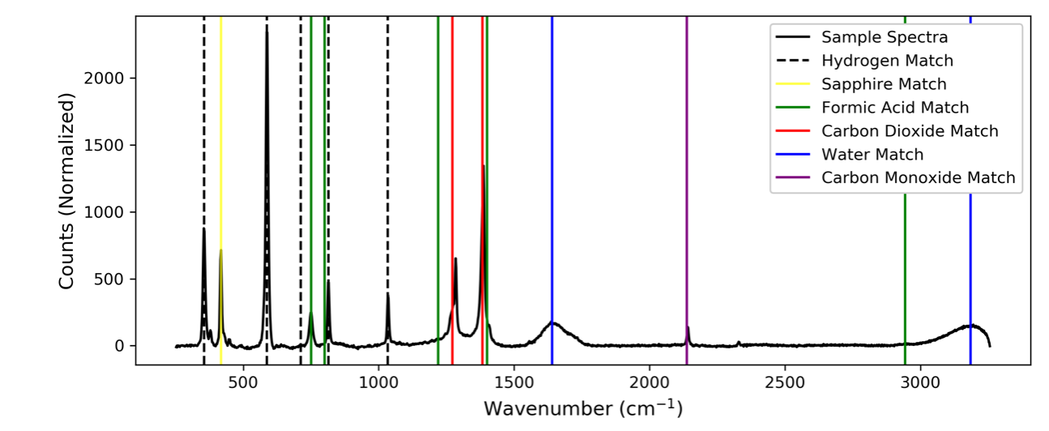
In-Situ Raman Spectroscopy Component Identification for Machine Learning Based Decomposition Analysis
Brandon Kern², Elizabeth Rasmussen^{1,3}, Jon Onorato^{2,3}, Parker Steichen²
¹ Department of Mechanical Engineering, ² Department of Material Science and Engineering, ³ Clean Energy Institute
University of Washington, Seattle, WA, USA
Introduction
Formic Acid gasified at 400°C
Pressure held constant at 25 MPa
Residence time of Xs
Constant fedstock concentration of 15 wt%
Continuing Work
Materials and Methods
Using data from a custom built supercritical gasification reactor on campus to analyze formic acid Raman spectra.
Decomposition of formic acid constitutes the combination of two pathways:
Baseline Subtraction of Raman Signal
Machine Learning for Material Decomposition
We implemented functionality to run a least squares regression that fits Lorentzian curves to the data. The function is given the peak locations determined using scipy.signal.find_peaks.
Expand software to be able to compute decomposition rates across varying parameters such as temperature, resonance time, possibly pressure.
From the defined decomposition rate the software can predict the decomposition rates using machine learning beyond the known data set limits
Used PeakUtils built in baseline function to perform polynomial fit baseline subtraction on NIST database spectra. Examples of this functionality are shown below.
Water Baseline Subtraction Output
Acetone Baseline Subtraction Output
Photographs of UW Gasification Reactor with In-Situ Raman Probe
Component Analysis in a Mixture Raman Signal
The LMFit package was utilized to identify 5 descriptors per peak in a mixture’s Raman signal including: location of the peak, peak height, and peak width. As a mixture has more peaks (components from decomposition) the amount of descriptors increases.
Carbon Monoxide Spectra Lorentzian Output
Least Squares Model Equation
Motivation
Lorentzian Equation for a Single Peak
Component Condidence based on Euclidean Distance
Conclusions and Future Work
In conclusion
Future work
This work sets up a free and user friendly platform for researchers to be able to analyze their own Raman Spectra
Results Using Experimental Data
Goals
Acknowledgements
Data Mining and Baseline Subtraction
Importing open source data sets, create a library of spectra, uniformly format data for analysis
Data Visualization
Outputting plots of baseline subtraction and peak identification
Machine Learning
Prepare least squares regression model for calculating kinetic rate decomposition at different resonance times and temperatures
Dave Beck, Chad Curtis, and Kelly Thornton
Data sets were taken from publicly available from the NIST WebBook Database and Mendeley Data, “Raman Spectra of Formic Acid Gasification Products in Subcritical and Supercritical Water”
Only open source packages were used in this work, documentation of all packages used can be found at our GitHub at:
https://github.com/raman-noodles/Raman-noodles

